Slide 1

307401 Big Data and Data Warehouses
Inside Google Data Center
https://www.cnet.com/pictures/peeping-inside-googles-data-centers-pictures/
https://www.youtube.com/watch?v=avP5d16wEp0

Slide 2
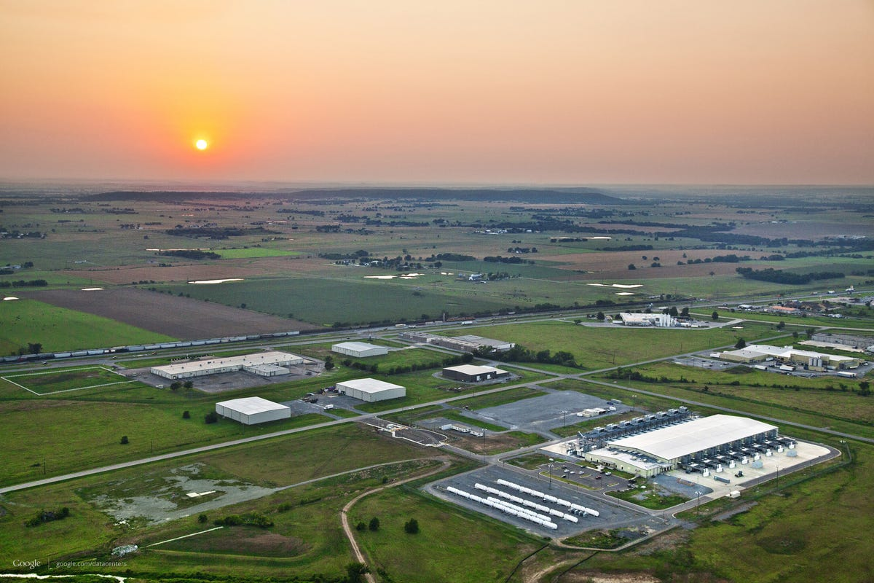


Oklahoma data center from the air Google's data center in Pryor, Okla

Slide 3
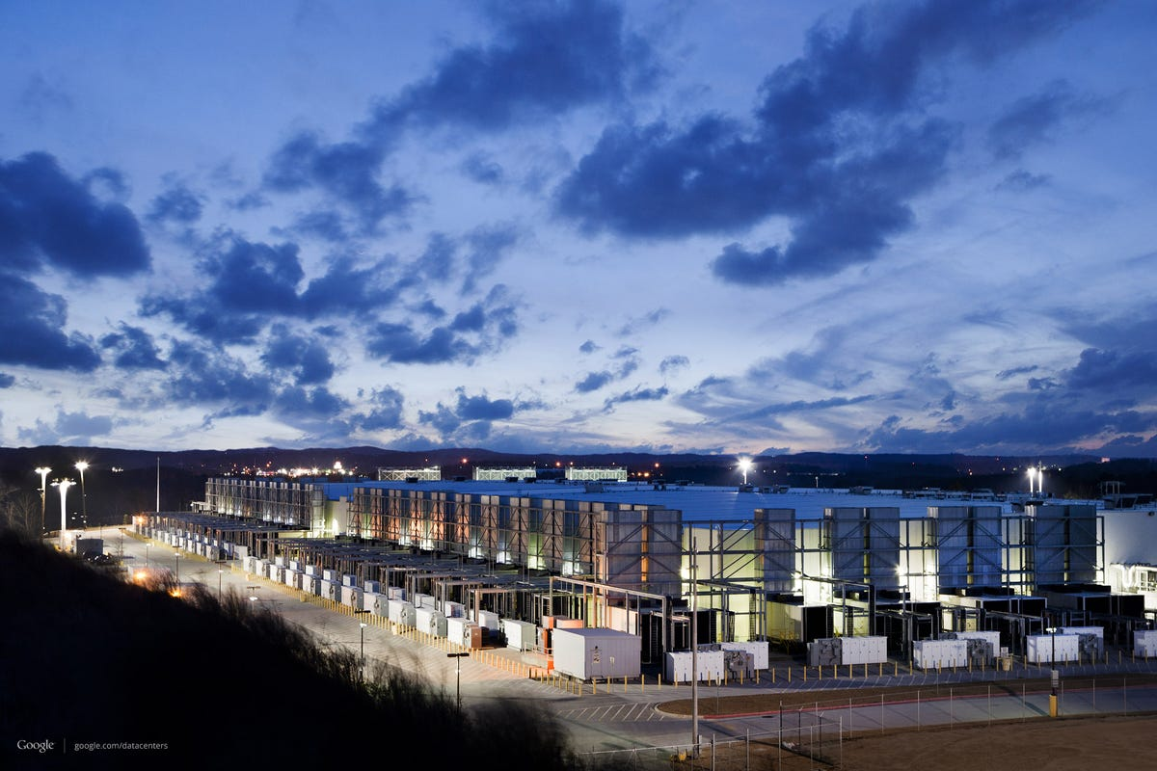
Google's Atlanta data center by night A Google data center outside Atlanta, Ga.

Slide 4
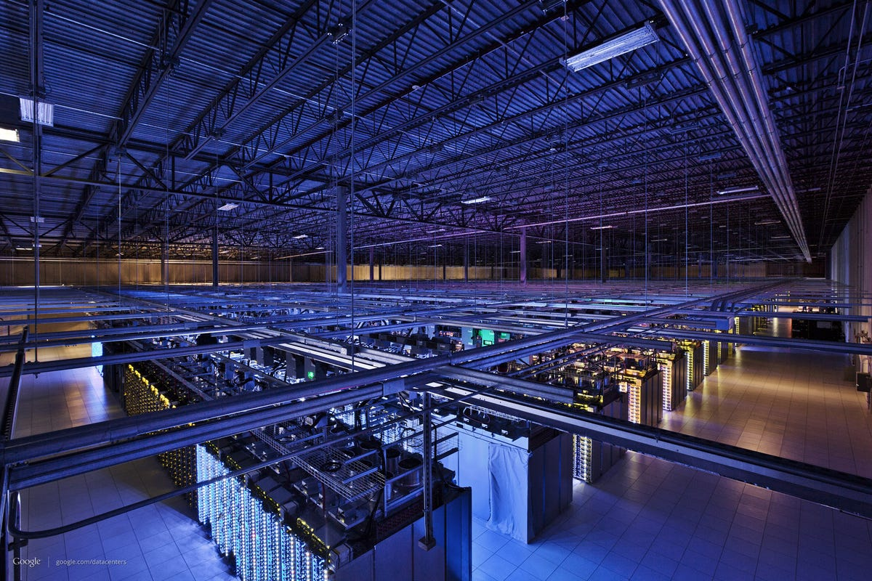
Google data center in Council Bluffs, Iowa Google's data centers can be vast. This one in Council Bluffs, Iowa, has more than 115,000 square feet of room.

Slide 5
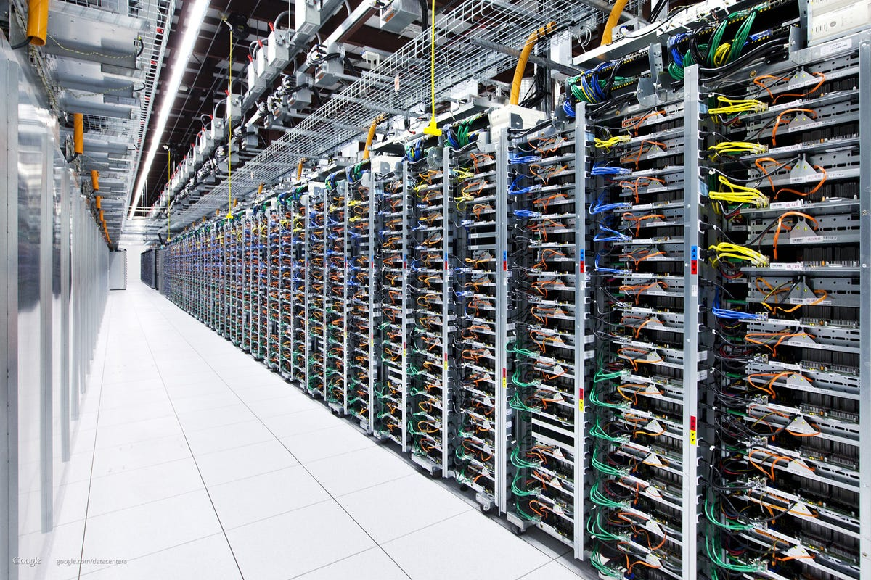
Colored cables in Google data center Google uses huge numbers of servers, as evidenced by this long shot down one data center aisle. The colored cables are standardized across the company's data centers worldwide so their function is clearer.

Slide 6
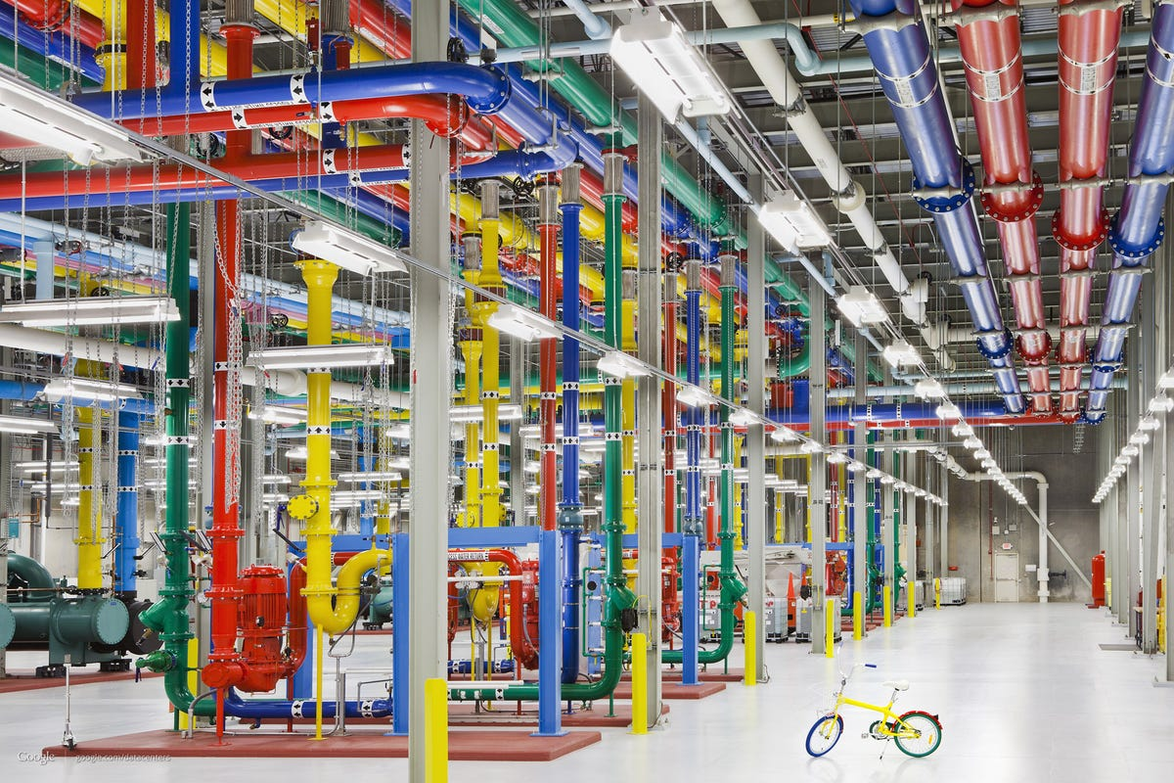
Google's colored pipes Google's data centers use color-coded pipes to indicate what they're used for. Pink means water headed for outside cooling towers. Google employees use bicycles to get around their data centers.

Slide 7
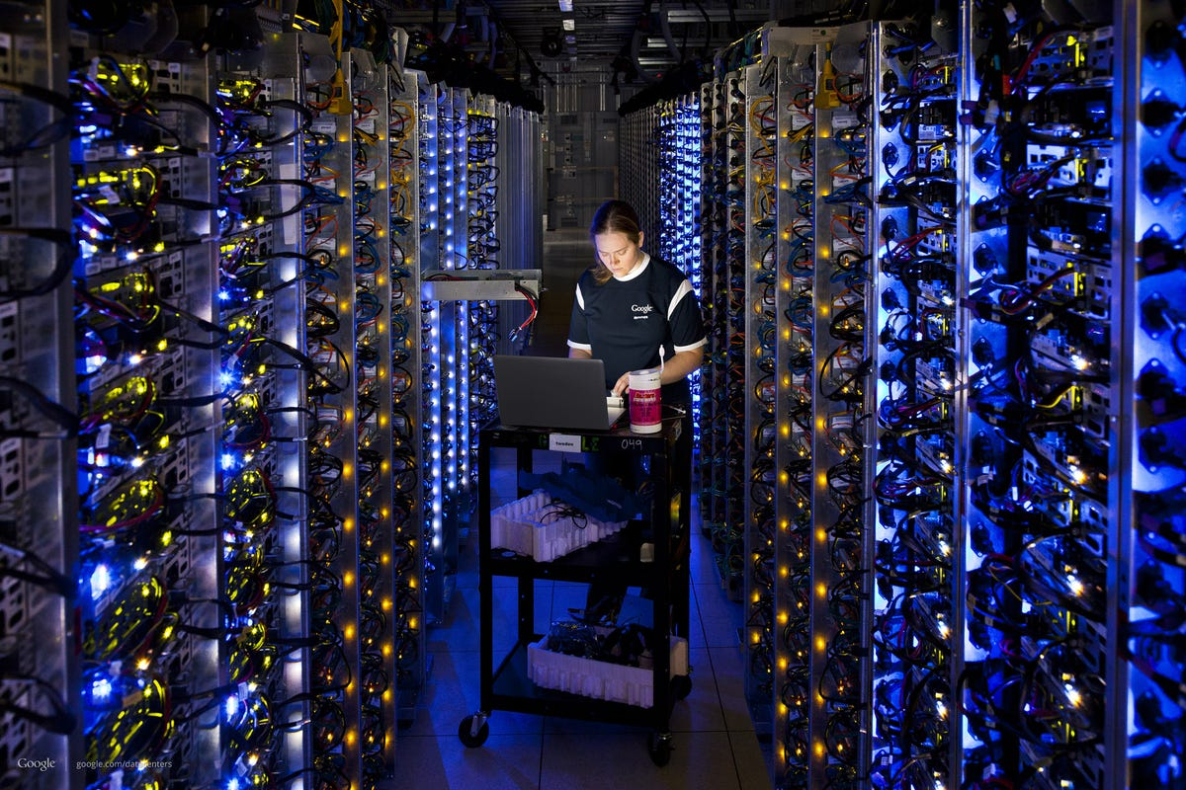
Fixing a Google server Denise Harwood diagnoses an overheating CPU inside a long aisle between racks of computing gear in a Google data center.

Slide 8
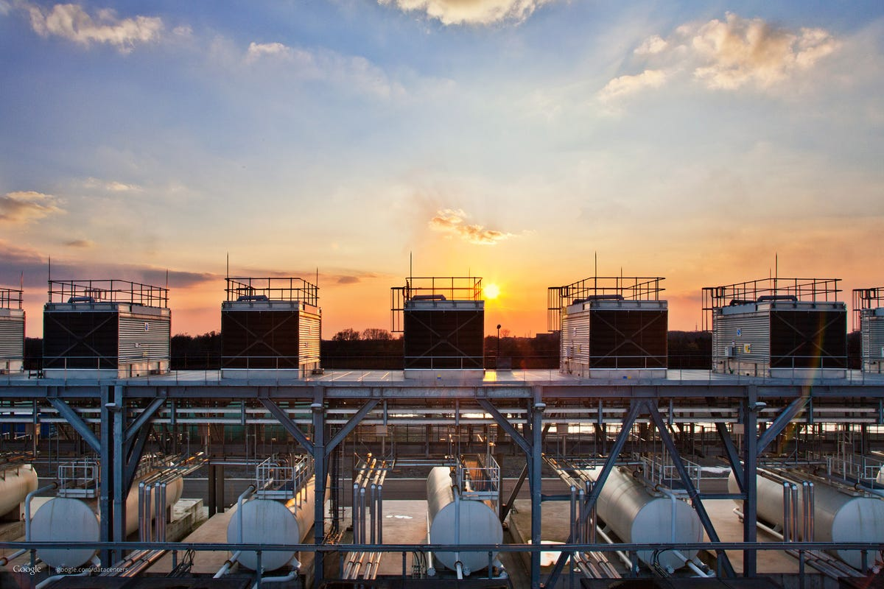
Google cooling towers These are the water tanks and cooling towers for Google's data center in Saint Ghislain, Belgium.

Slide 9
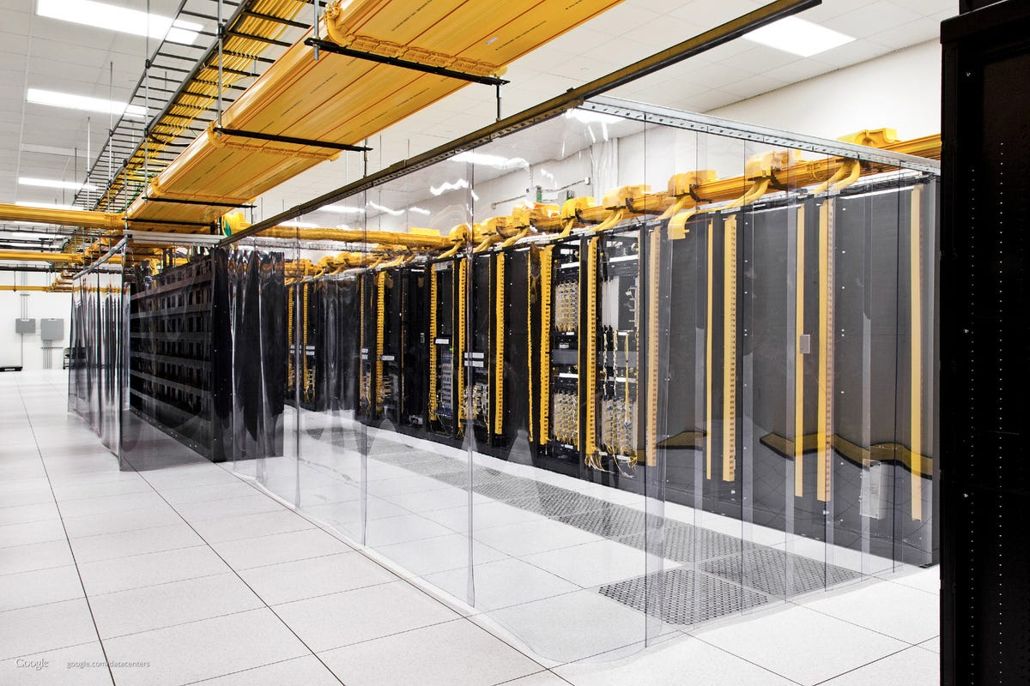
Cold curtains Transparent plastic curtains keep the cool air around servers in a Google data center in Council Bluffs, Iowa.

Slide 10
Google Infrastructure – Rough Estimate
Data Centers: Over 70 worldwide
Servers per Data Center: Estimated 50,000 to 200,000
Total Servers Globally: Several million
Operating System: Custom Google Linux distribution
Regions: 34 globally
Availability Zones: Multiple per region
Example Regions:
US-Central1 (Iowa)
Europe-West1 (Belgium)
Asia-East1 (Taiwan)

